Slide 1
Multi-Label Emotion Classification on
Trending Tweets using Machine Learning
Presented By
Simon Islam

Slide 2
Introduction
Multi-label Classification
  Multiple labels assigned to each instance
  Classes aren’t mutually exclusive
  Has no constraint on class assignment
Example: @tommcfly hope u enjoy the movie! AND have fun tomorrow I don't think I'm gonna make it to your show
Emotions Present: Joy, Sadness.

Slide 3
Introduction (Cont.)
Motivation
  Trends are changing on daily basis.
  Marking posts as positive or negative are not enough
  Training a model to perform multi-label emotion analysis
Why Twitter?
  Has 330 million users
  Reach is not limited
  Can determine current trends based on tweets

Slide 4
Problem Statement
Using the Trends feature of Twitter, the task is to gather the trending tweets and label them according to their emotions. It can range from one label to multiple labels to describe the emotions properly.

Slide 5
Objectives
To extract real time trending tweets from twitter
To perform Multi-Label Emotion Classification of the tweets (sadness, disgust, joy, interest, admiration, anger, surprise & fear)

Slide 6
Related Works
S. M. Liu and J.-H. Chen, “A multi-label classification based approach for sentiment classification,” Expert Systems with Applications, vol. 42, no. 3, pp. 1083–1093, Feb. 2015. [1]
Used various classification methods to perform multi-label classification
Used 3 different sentiment dictionaries
8 state of the art multi-label classification methods were conducted
Limitations:
Only used text segmentation, didn’t consider other aspects like emoticons etc.
Datasets limited to tweets concerning two incidents

Slide 7
Related Works (Cont.)
M. Bouazizi and T. Ohtsuki, “Multi-class sentiment analysis on twitter: Classification performance and challenges,” Big Data Mining and Analytics, vol. 2, no. 3, pp. 181–194, Sep. 2019. [2]
Proposed a multi-class classification approach
Used 7 sentiment classes to label 2 datasets
Used their software called SENTA to extract features and classification
Limitations:
Does not recognize multiple emotions in a tweet
Used 3 pairs of opposite emotions

Slide 8
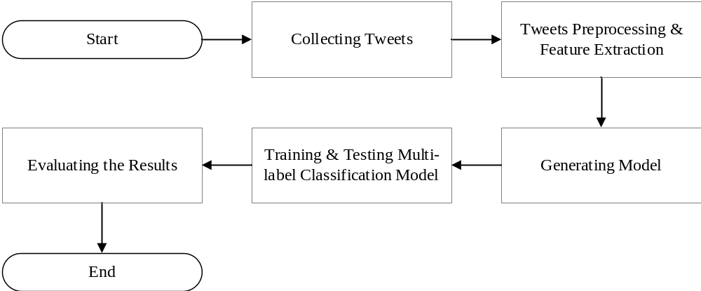
Methodology
Outline of the Methodology

Slide 9
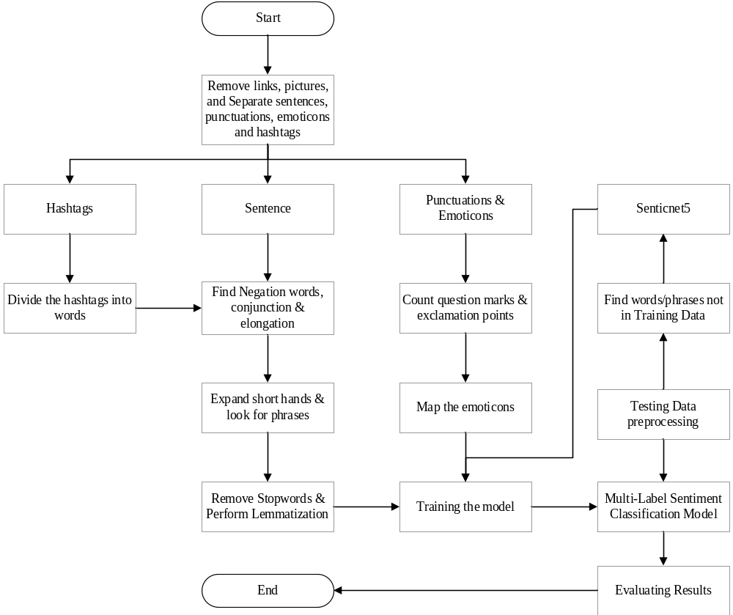
Methodology (Cont.)

Slide 10
Results
Name of Emotion | No of Tweets
Joy | 1907
Sadness | 3675
Anger | 844
Disgust | 1320
Admiration | 559
Surprise | 801
Interest | 1653
Fear | 612
Table 1. Distribution of labels in dataset

Slide 11
Results (Cont.)
Number of Labels | Number of Tweets
0 | 312
1 | 4056
2 | 2764
3 | 498
4+ | 71
Total | 7701
Table 2. Number of present labels in tweets
Tweets used for training: 6919
Tweets used for testing: 782

Slide 12
Results (Cont.)
Evaluation | Binary Relevance
 | RFC | SVM
Hamming Loss | 0.249 | 0.279
Subset Accuracy | 0.714 | 0.668
Micro F1 | 0.832 | 0.812
Macro F1 | 0.827 | 0.807
Average Accuracy | 0.750 | 0.721
Table 3. Evaluations

Slide 13
Conclusion
Can classify tweets in multiple labels
Will get real time reactions from events
Has a low hamming loss indicating it’s success in detection

Slide 14
Reference
[1]. S. M. Liu and J. H. Chen, “A multi-label classification based approach for sentiment classification,” Expert Syst. Appl., vol. 42, no. 3, pp. 1083–1093, 2015, doi: 10.1016/j.eswa.2014.08.036.
[2]. M. Bouazizi and T. Ohtsuki, “Multi-class sentiment analysis on twitter: Classification performance and challenges,” Big Data Min. Anal., vol. 2, no. 3, pp. 181–194, 2019, doi: 10.26599/BDMA.2019.9020002.
[3]. L. A. Cabrera-Diego, N. Bessis, and I. Korkontzelos, “Classifying emotions in Stack Overflow and JIRA using a multi-label approach,” Knowledge-Based Syst., vol. 195, p. 105633, 2020, doi: 10.1016/j.knosys.2020.105633.
[4]. A. Go, R. Bhayani, and L. Huang, “Twitter Sentiment Classification using Distant Supervision,” Processing, vol., pp. 1–6, 2009.
[5]. E. Cambria, S. Poria, D. Hazarika, and K. Kwok, “SenticNet 5: Discovering conceptual primitives for sentiment analysis by means of context embeddings,” in Thirty-Second AAAI Conference on Artificial Intelligence, 2018.

